Slide 1

Digital Marketing

Slide 2
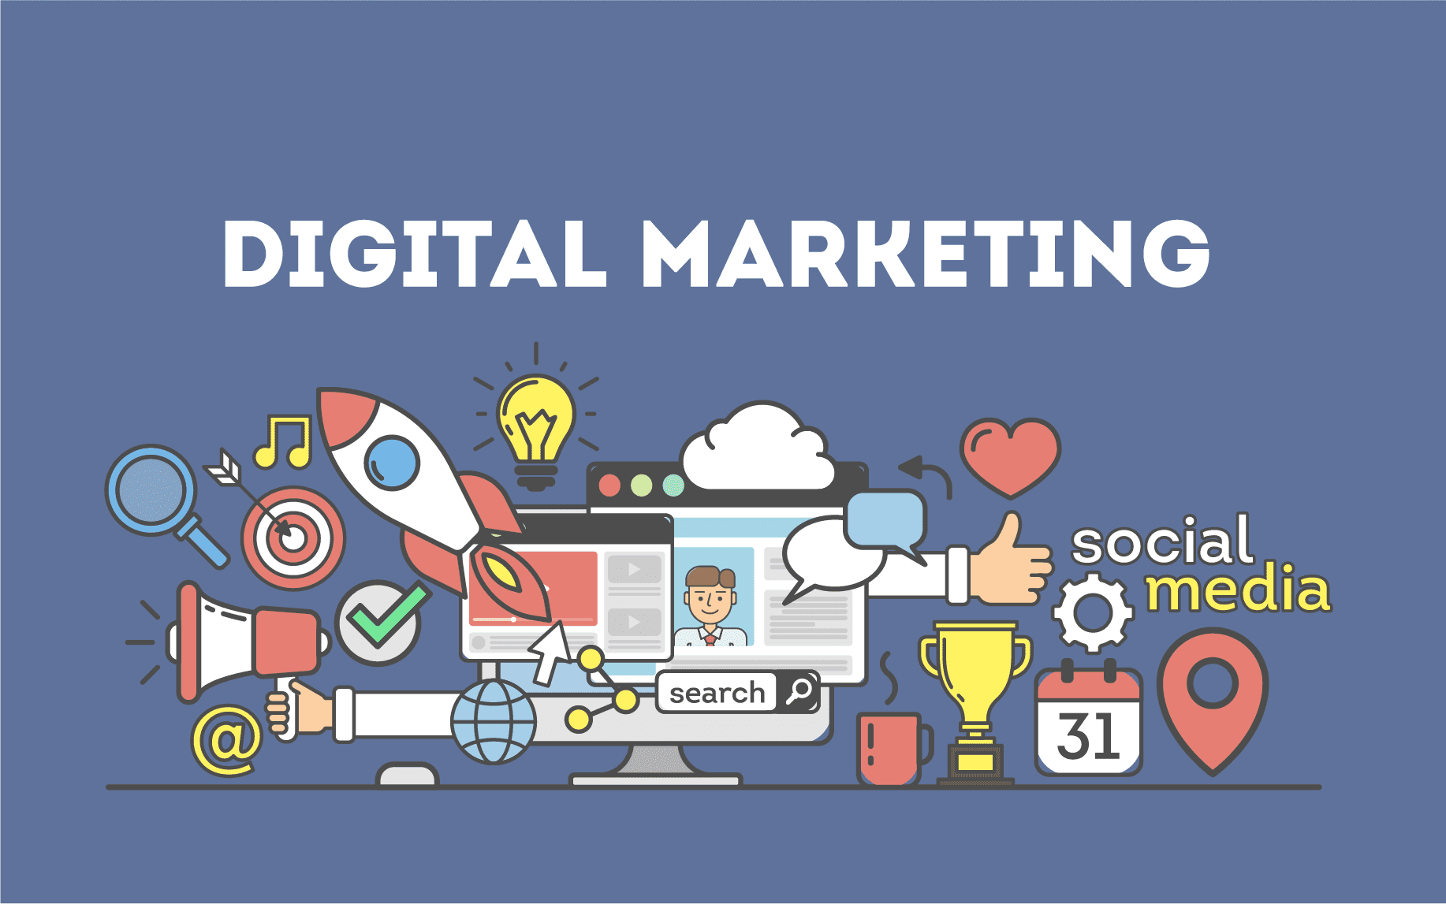

Slide 3

Digital marketing refers to the use of digital channels, such as the internet, social media platforms, search engines, email, mobile apps, and other digital technologies to promote products, services, or brands. It encompasses a wide range of marketing activities that are carried out online to reach and engage with a target audience.
Digital marketing leverages various strategies and tactics to drive brand awareness, generate leads, increase website traffic, and ultimately, achieve business goals

Slide 4
User Research

Slide 5
Surveys: The basics of surveys, types of surveys, the process of conducting surveys, formulating survey questions and analyzing the data collected through surveys
User Interviews: The basics of interviews, the process of conducting interviews, the dos and don’ts to remember, formulating interview questions and analyzing the data collected through interviews
Contextual Inquiry: The basics of contextual inquiry, the process of conducting contextual inquiry, how it is conducted in the industry and a demonstration of it

Slide 6
SURVEYS
Surveys are a common method of user research. A survey typically comprises of a series of questions with structured answers that mainly provide quantitative data on users’ opinions, such as what users like or dislike about a product

Slide 7



Slide 8
SURVEYS
The various types of surveys are:
Market research survey: It helps you understand the environment in which your product operates, figure out the pricing for a new product, and ways to improve customer retention
Customer satisfaction survey: It serves to assess the efficiency of your product in the market and determine the areas that need improvement
Net promoter score (NPS): It helps you check how likely users are to recommend your product to others

Slide 9
SURVEYS
For conducting a survey, you need to:
Define the objectives of the survey
Identify the target audience and calculate the sample size
Frame the questions you want to ask
Carry out the survey and collect the data
Analyze the data to derive insights

Slide 10
SURVEYS
The types of questions you can ask in a survey are:
Categorical questions: These include yes/no questions and MCQs
Ordinal questions: Such questions are used for elements that have a proper order, and you can get counts or percentages to define this order
Interval/Ratio questions: It can be the Likert scale (‘strongly agree’ to ‘strongly disagree’) or the ranking scale
Matrix questions: It’s a grid where multiple items can be rated on one scale
Textbox questions: This can be used to gather respondent-specific data

Slide 11

User interviews
An interview is a one-on-one discussion with your user that goes deep into the user’s background, experiences and needs. It can help you validate your idea and gather feedback on your communication theme or product features.

Slide 12
The different types of interviews are:
Exploratory interview: It helps you discover the pain points of the user and get ideas for new products/features
Validation interview: It serves to test your hypothesis and verify whether your thoughts about the product are shared by the users
Satisfaction-oriented interview: Through it, you can assess user response towards your product
Efficiency interview: This helps you improve the product according to the likes and dislikes of the user
Usability interview: This type of interview is usually conducted when the initial prototypes are made, and it focuses on observing the user while he/she interacts with the prototypes

Slide 13
The Process of Conducting Interviews
A few things you need to keep in mind are:
Identify your interviewees
Make a rough script
Inform participants of your purpose for conducting the interview, and assure them of anonymity
Avoid asking leading questions
Keep the session short
Take a break between interviews
Make the interviewee comfortable and encourage honest and open responses

Slide 14
Creating Interview Questions
The primary rules for creating interview questions are:
Don’t rationalize your decisions with the user; instead, listen to what he/she has to say
Don’t ask hypothetical questions just to pitch your product
You should cover the following aspects during your interviews:
The problem faced by the user
The frequency with which the user faces this problem
The last time the pain point occurred
What the user has done to solve the problem
What the user like/disliked about the solutions

Slide 15
Analyzing Data Collected through Interviews
After you’ve completed the entire interview process, you will be left with a lot of data about your user’s needs and expectations. At this juncture, it’s important to analyze this data in a proper manner so as to get the most accurate insights.

Slide 16


Slide 17
Contextual Inquiry
Contextual inquiry is an important step in user research which enables you to observe your user directly while he/she performs tasks in the problem space. But it’s not just observation — the participant also talks about what he/she is doing and, in this way, you get live information on the kind of circumstances in which you can expect your product to be used. This information is invaluable in designing a product that understands the user’s context and meets his/her expectations.

Slide 18
In contextual inquiry, the focus is more on observation than straightforward questioning. This user research method helps you:
Gain first-hand information about user behavior
Minimize errors and add an additional layer of objectivity
Identify gaps in the problem space

Slide 19
Process of Conducting Contextual Inquiry
Conducting contextual inquiry may seem like a straightforward task, but you should be cognizant of all the steps and considerations involved in this user research method. Besides, you also need to know how to ask questions that arise in your mind, and how to make the participant comfortable so that you can collect accurate data.

Slide 20
To conduct a contextual inquiry session, you need to identify the problem statement and the target group. You also need to keep in mind that you should let the participant perform the task as he/she naturally would. Interrupting the participant and asking leading questions will yield inaccurate and faulty data regarding distractions and personality clues, and the technology and workarounds employed by the user.

Slide 21
Contextual Inquiry - Tips
Keep your distance — ensure that you don’t make the participant too conscious of your presence
Keenly observe all the steps the participant takes while performing the task
Record the session or take notes so that you can ask follow-up questions afterwards

Slide 22
A product/marketing manager makes frequent visits to doctors’ clinics in order to observe the processes and workflows that occur in that habitat. This is what gives them deep insights into how they can build a better product for their customers and users.

Slide 23
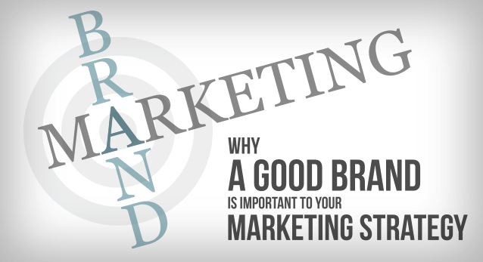

Slide 24
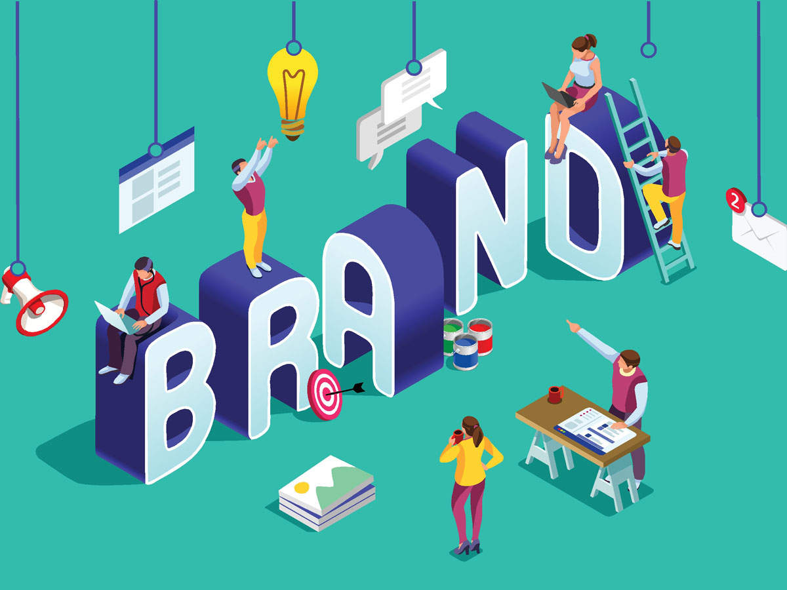
BRAND POSITIONING.

Slide 25
Brand Positioning is a fundamental step in your entrepreneurial journey. Entrepreneurs are usually confronted by questions like:
What do I want my brand to stand for?
What perception should consumers carry about my brand?
What are the values that I want to convey?
How do I want to communicate those to my consumers?

Slide 26
Introduction to Positioning
Brand Positioning is a process through which marketers create a distinct brand image or identification of their product/service in the minds of their customers. It is an essential step in every marketer's journey.

Slide 27
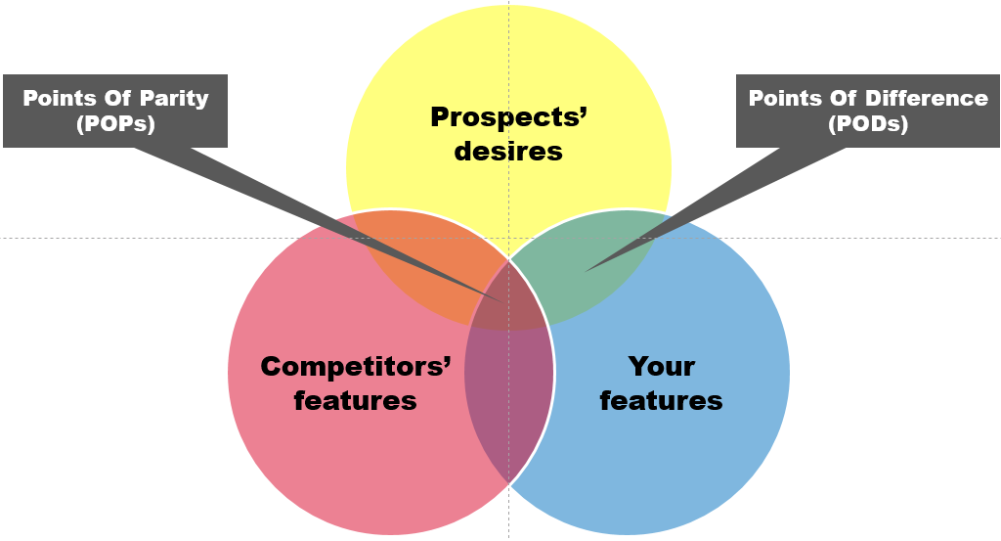
A point of parity is any area where your business is the same as your competitors to be a buying consideration for your customers. Point of difference refers to the factors of products or services that establish differentiation.

Slide 28
Designing a Positioning Strategy
To start off, you must decide on the following:
Target Customers
Product/Service
Value Proposition
Differentiation or USP (Unique Selling Proposition)

Slide 29
The Marketing mix.
Product
Price: Pricing strategies
Place: Distribution channels
Promotion

Slide 30

Product
In digital marketing, the product refers to the digital offering or service that a company provides. This can include software, mobile applications, online courses, e-books, streaming services, and more. The product should fulfill a need or solve a problem for the target audience. It is important to consider factors such as features, usability, design, and user experience to create a compelling digital product.

Slide 31

Price refers to the monetary value assigned to a digital product. In the digital realm, pricing strategies can vary widely. This can include one-time purchases, subscriptions, freemium models, pay-per-use, or tiered pricing structures
Price
Cost plus pricing (From provider’s perspective)
Perceived value-based pricing (From customer’s perspective)
Competitor based pricing

Slide 32

Place: Distribution Channels
A distribution channel is a path through which a product or service reaches the final consumer. It may reach either directly from the manufacturer to the user or through various intermediaries such as wholesalers, distributors, retailers etc.
You may also have intermediaries like distributors, dealers or wholesalers and eventually retailers for distributing products/services to the end consumers.
organizations can either reach the consumers through retail stores or supermarkets, which can be single brand or multi-brand.

Slide 33
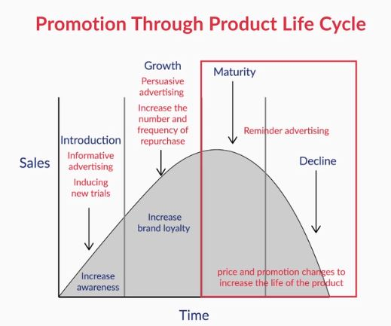
Promotion
Advertising
Sales promotions
Personal selling
Direct mail
Internet marketing
Social media
Sponsorship

Slide 34
Marketing Communication.

Slide 35
Concept & Relevance of Marketing Communication
Marketing communication is a means through which brands and organizations present themselves in front of its audience.
There could be multiple objectives of any marketing message like informing customers about the offerings; persuading current and potential customers or reassuring buyers once they have purchased the product. This approach to business is very cost-effective as it focuses more on customer retention than customer acquisition.
A good marketing communication campaign not only creates a unique product positioning in the market, but also convinces investors to invest in your venture over others.

Slide 36
Mediums of Marketing Communication
Mediums of marketing communications are very diverse in nature and can be categorized in the form of:
Advertising,
PR- Personal Relations,
Sales & promotion,
Direct marketing and
Personal selling
It is critical to understand the rationale of using each of these mediums. The stage of the company, target audience and available resources are some of the key factors in choosing one.

Slide 37
Developing Effective Communication
Different customers have different needs, so it is important to have customized forms of marketing communication designed to pull in that specific segment of your target audience. It is, therefore, very important to tailor your communication to meet the needs of your customers.
Developing an effective communication entails five steps:
Step-1: Determining the target audience
Step-2: Defining the objective of communication
Step-3: Developing the message
Step-4: Ascertaining the marketing budget
Step-5: Selecting the channel mix

Slide 38
Marketing Message Framework
A good marketing message should always reflect an image of your target audience. If you get it right, you create superior brand awareness and generate the interest of your investors as well. Your marketing message is often the first communication between you and your potential customer, which is why it’s important for you to get it absolutely spot on!
4E’s of Message Framework
Emotion
Explain
Evoke
Exclude/include Target Audience

Slide 39
Media Channel Selection
Decisions in media planning and selection are becoming increasingly multi-faceted and difficult as more media options are accessible. There are economic consequences of media selection too in terms of the impact on turnover and profitability of the company. Hence, it is crucial to make the right choice with regards to the media channel in order to send the right message for your product, service or brand to the right set of people at the right time.
various factors affecting the choice of media channels are:
ROI
Reach
Kind of message
Customer perception

Slide 40
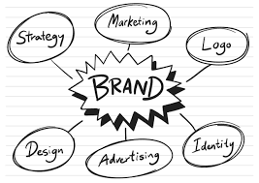
What is a Brand?
Generally, a brand can be described as a distinct identity or an image that a product or service carries in the market. A strong brand identity presents a positive image of your organization

Slide 41
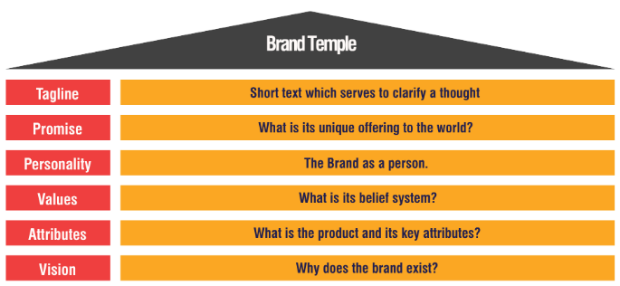
Brand Temple
One tool is quite effective in creating the first brand position – the Brand Temple.

Slide 42
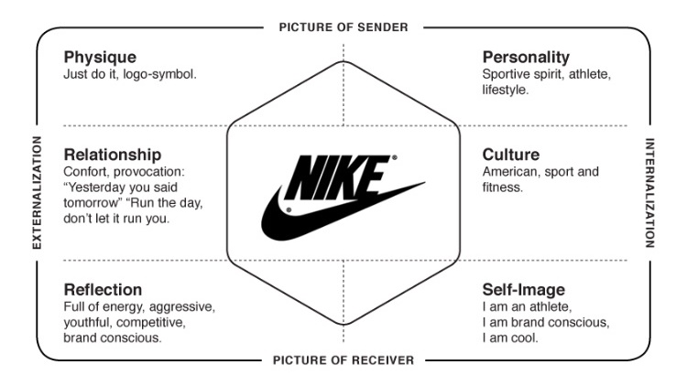
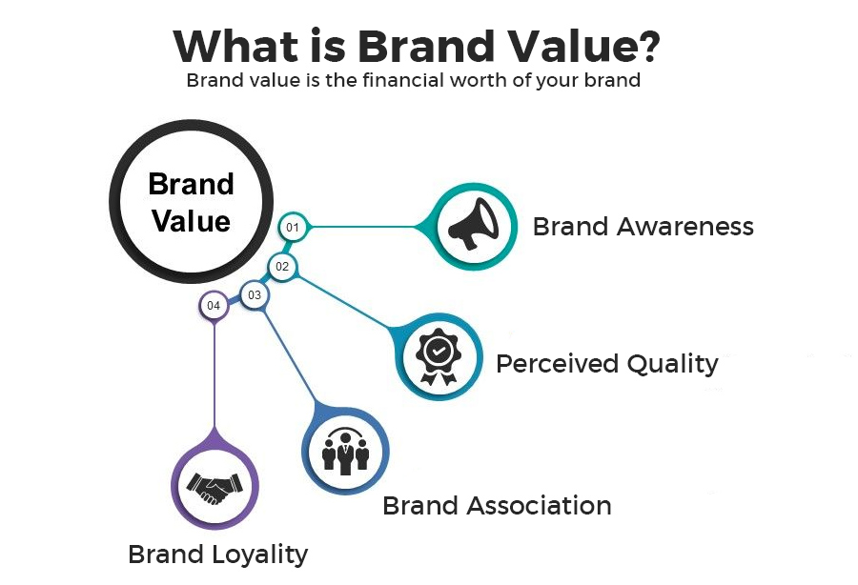
Brand Identity and Brand Value
Brand identity is an overall look and a visual image of the brand created in the mind of a consumer

Slide 43
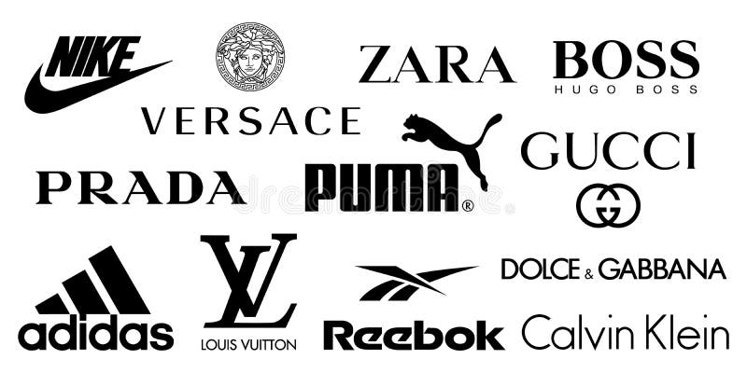
Executing a Brand Strategy

Slide 44
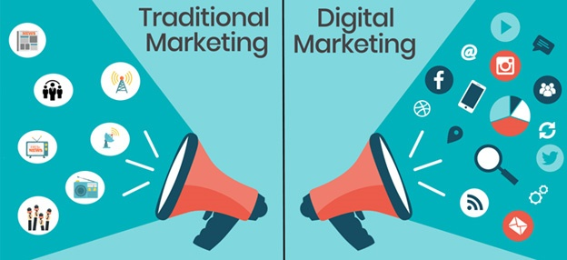

Slide 45
Digital v/s Traditional Marketing
Traditional Marketing: This includes traditional advertising channels such as television, radio, newspapers, magazines, billboards, direct mail, and event sponsorships.
Generally, traditional marketing is less targeted and personalized. It relies on reaching a broad audience through mass media, and as a result, it may be less effective in reaching specific niche markets.
Digital Marketing: This encompasses online channels such as websites, search engines, social media, email marketing, content marketing, online ads (e.g., banner ads, video ads), and influencer marketing.
Digital marketing allows for highly targeted and personalized campaigns. Data analytics and online tools enable marketers to segment audiences based on demographics, behavior, interests, and preferences, delivering more relevant content and ads.

Slide 46
DIFFERENT DIGITAL MARKETING CHANNELS AVAILABLE:
Website
SEO
SEM
Content marketing
Social media marketing
Retargeting

Slide 47


Slide 48
Website
website can be used for:
Engagement
Lead generation
Data collection
Search engine optimization, and
Conversion
Website customization:
Navigation – It should be easy for users to navigate your website
Information - Provide right amount of information at the right part of the funnel
Relevancy - Information and navigation flow should be relevant
Checkout Flow - The checkout process should be as smooth as possible
Data Collection - Be clear on what you want to track on your website and start immediately

Slide 49
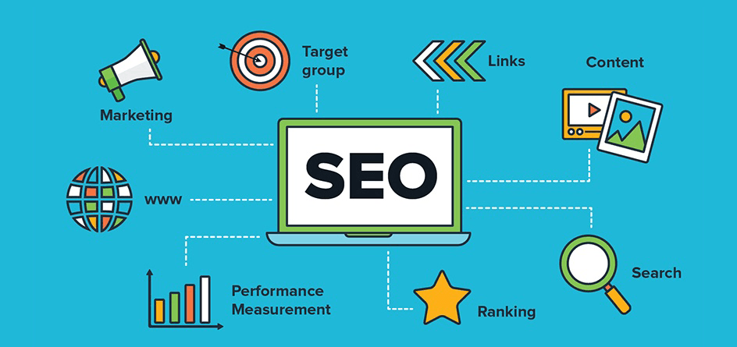

Slide 50
Search Engine Optimization
One of the key differences between SEO and SEM is the fact that SEO is an earned marketing channel. Through continuous improvement of your digital assets, your search results will move up the ladder for free
The two categories of SEO are on-page SEO and off-page SEO

Slide 51
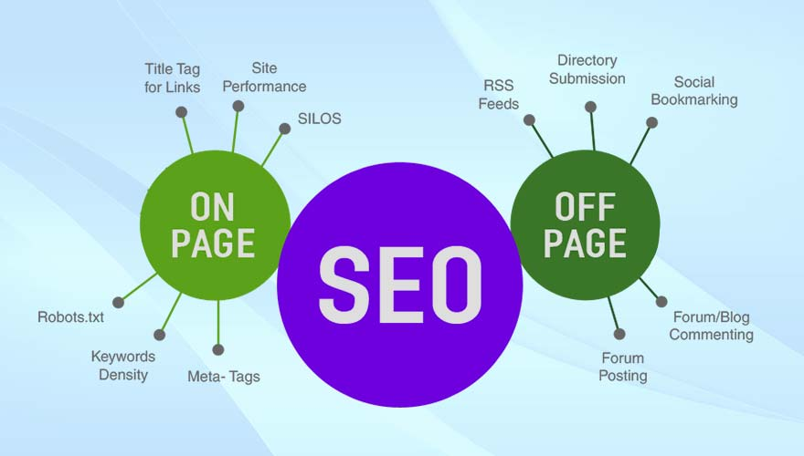

Slide 52
On-page SEO: On-page SEO refers to the practices and optimizations done directly on a website's pages to make them more search engine-friendly and user-friendly. The primary focus of on-page SEO is to ensure that the content and structure of the website are optimized to meet the search engine's criteria for relevancy and quality. Some key elements of on-page SEO include:
Keyword Optimization: Conducting keyword research and strategically incorporating relevant keywords into the website's content, title tags, meta descriptions, headings, and URLs.
Content Quality: Creating high-quality, relevant, and valuable content that satisfies the user's search intent and addresses their needs.
Meta Tags: Writing compelling and descriptive title tags and meta descriptions for each page, as these appear in search engine results.
URL Structure: Creating user-friendly and descriptive URLs that include relevant keywords.
Header Tags: Using proper header tags (H1, H2, H3, etc.) to structure content and indicate its hierarchy.
Internal Linking: Linking related pages within the website to improve navigation and help search engines understand the website's structure.
Image Optimization: Optimizing image files with descriptive alt tags to make them more accessible to search engines.
Mobile-Friendliness: Ensuring the website is responsive and provides a good user experience on mobile devices.
Page Speed: Improving page loading speed to enhance user experience and search engine ranking.

Slide 53
Off-page SEO: Off-page SEO refers to the actions taken outside the website to improve its visibility and authority in search engine rankings. These actions are typically focused on building the website's reputation and credibility in the online community. The most important aspect of off-page SEO is link building, which involves acquiring backlinks (links from other websites) that point to the target website. Some key elements of off-page SEO include:
Link Building: Earning high-quality backlinks from reputable and relevant websites. Search engines consider backlinks as "votes of confidence" for a website's authority and trustworthiness.
Social Media Marketing: Leveraging social media platforms to share content, engage with the audience, and promote the website's brand.
Influencer Marketing: Collaborating with influencers or industry experts to increase brand exposure and gain more backlinks.
Guest Blogging: Writing and publishing content on other authoritative websites in exchange for a backlink.
Online Brand Mentions: Monitoring and managing brand mentions across the web to ensure a positive online reputation.
Social Bookmarking: Submitting and sharing website pages or blog posts on social bookmarking platforms to increase visibility.
Online Reviews and Citations: Encouraging positive reviews and getting listed on reputable business directories.
Forum Participation: Engaging in relevant forums and communities to build authority and generate traffic.

Slide 54
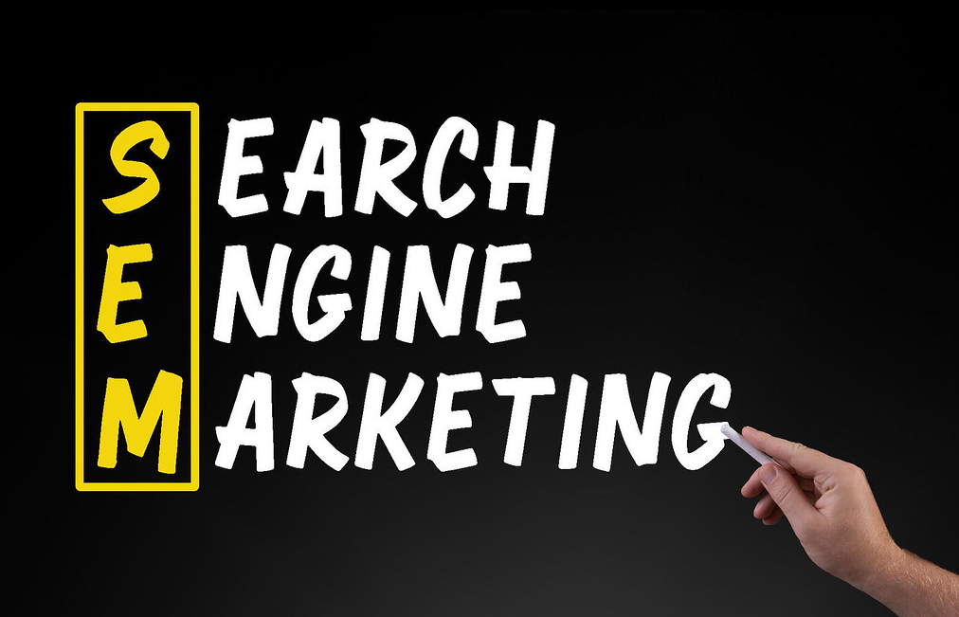

Slide 55
Search Engine Marketing
In the last video, you understood the key concepts of Search Engine Optimization (SEO). The other way of improving your visibility online is through Search Engine Marketing (SEM). Unlike SEO, SEM is paid and allows you to keep control of your online appearance on a search result
Steps that you should follow in order are:
Step 1: Setting up an account structure
Step 2: Choosing campaigns
Step 3: Keyword research
Step 4: Creating ad copies
Step 5: Tracking campaign performance
Step 6: Budgeting and bidding

Slide 56
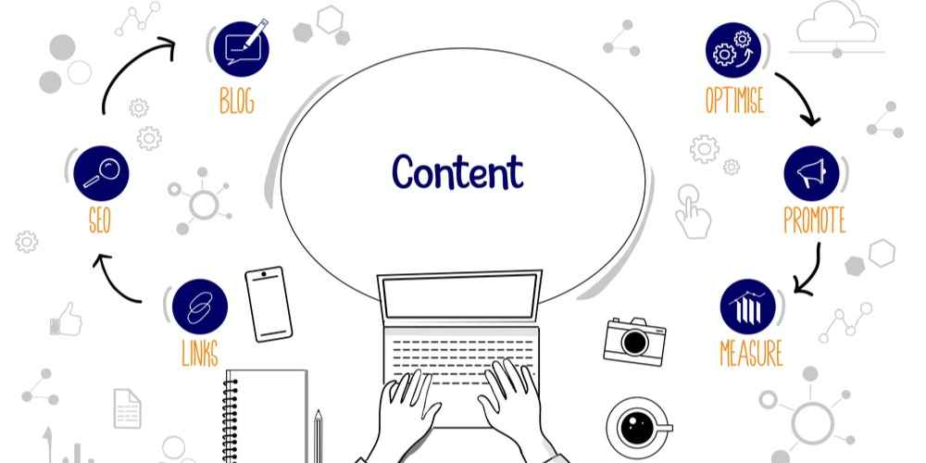

Slide 57
Content Marketing
Content Marketing has been one of the most discussed areas of marketing within the last few years.
steps that should be taken for content marketing. They are:
Step 1: Identify Consumer Persona
Step 2: Map Content to Consumer Funnel
Step 3: Where and How to Serve Content?
Step 4: Measure Content Performance

Slide 58
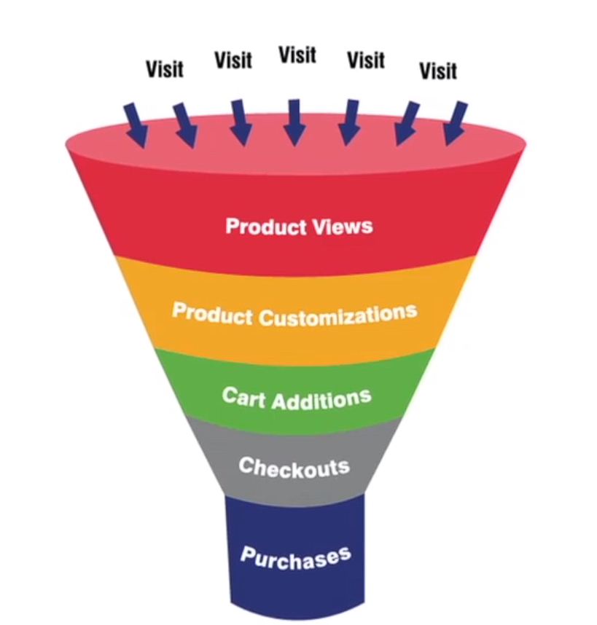

Slide 59
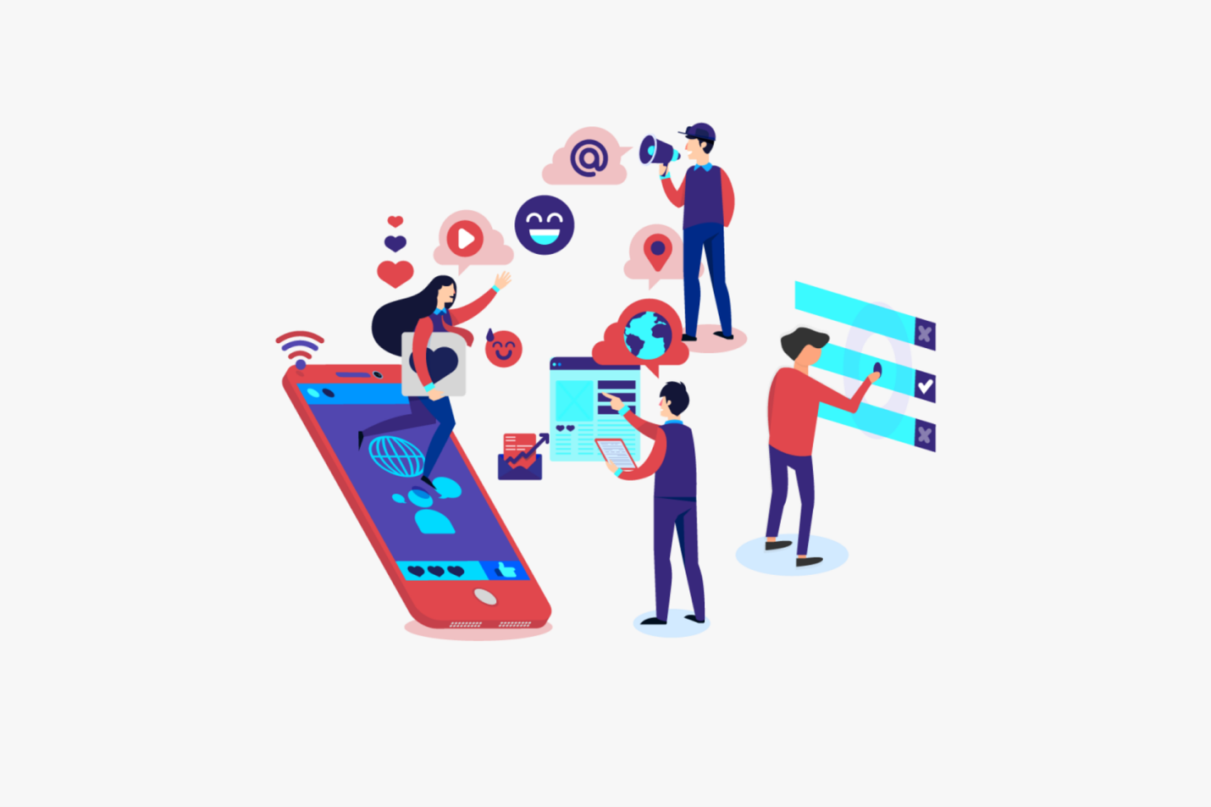
Social Media Marketing

Slide 60
Social media marketing is a form of digital marketing that utilizes social media platforms to promote products, services, or brands. It involves creating and sharing content, engaging with users, and running paid advertising campaigns to increase brand visibility, drive website traffic, and ultimately achieve specific business goals.
Key elements of social media marketing include:
Social Media Strategy: Developing a clear plan outlining the goals, target audience, content types, posting frequency, and platforms to be used.
Content Creation: Creating high-quality, relevant, and engaging content such as posts, images, videos, and stories tailored to each platform.
Community Engagement: Interacting with the audience through comments, messages, and sharing user-generated content to foster a sense of community and build brand loyalty.
Paid Advertising: Utilizing the advertising features of social media platforms to reach a wider audience and drive traffic to the website or landing pages.
Influencer Marketing: Partnering with influencers or popular individuals on social media to reach their followers and gain credibility and trust.
Analytics and Tracking: Monitoring and analyzing the performance of social media campaigns using various metrics to measure success and make data-driven decisions

Slide 61
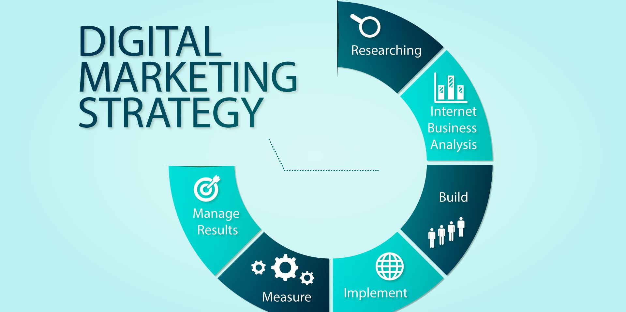

Slide 62
Building a robust digital marketing strategy involves several key steps to ensure a comprehensive and effective approach. Here are the steps you should consider:
Set Clear Objectives: Define your specific and measurable goals for the digital marketing strategy. These objectives could include increasing website traffic, generating leads, boosting sales, improving brand awareness, or enhancing customer engagement.
Know Your Target Audience: Understand your target audience's demographics, preferences, behavior, and pain points. This information will help you tailor your marketing messages and choose the right platforms to reach your audience effectively.
Conduct a Competitor Analysis: Analyze your competitors' digital marketing strategies to identify their strengths and weaknesses. This will provide insights into industry trends and help you differentiate your brand from others.
Choose the Right Digital Channels: Select the most appropriate digital marketing channels to reach your target audience. This may include social media, search engines, email marketing, content marketing, influencer marketing, and more.
Content Strategy: Create a content strategy that aligns with your goals and resonates with your audience. Develop valuable, relevant, and engaging content that educates, entertains, or solves problems for your target audience.

Slide 63
Search Engine Optimization (SEO): Optimize your website and content to rank higher in search engine results. Effective SEO practices will increase organic traffic and improve your online visibility.
Paid Advertising: Consider using pay-per-click (PPC) advertising on platforms like Google Ads or social media advertising to complement your organic efforts and drive targeted traffic to your website.
Email Marketing: Build and maintain an email list to nurture leads, deliver personalized content, and promote products or services. Email marketing is an effective way to engage with your audience and drive conversions.
Social Media Engagement: Engage with your audience on social media platforms actively. Respond to comments, messages, and user-generated content to foster a sense of community and build brand loyalty.
Measurement and Analytics: Implement tools to track the performance of your digital marketing efforts. Analyze key metrics to assess the success of your strategies and identify areas for improvement.
Budget Allocation: Allocate your budget effectively across various digital marketing channels based on their performance and potential for reaching your objectives.
Test and Iterate: Continuously test different marketing approaches and strategies to optimize your campaigns. Use A/B testing to compare the effectiveness of different elements and refine your tactics accordingly.
Stay Updated: Digital marketing is a dynamic field, with new trends and technologies emerging regularly. Stay updated with industry news and changes to adapt your strategy accordingly.

Slide 64
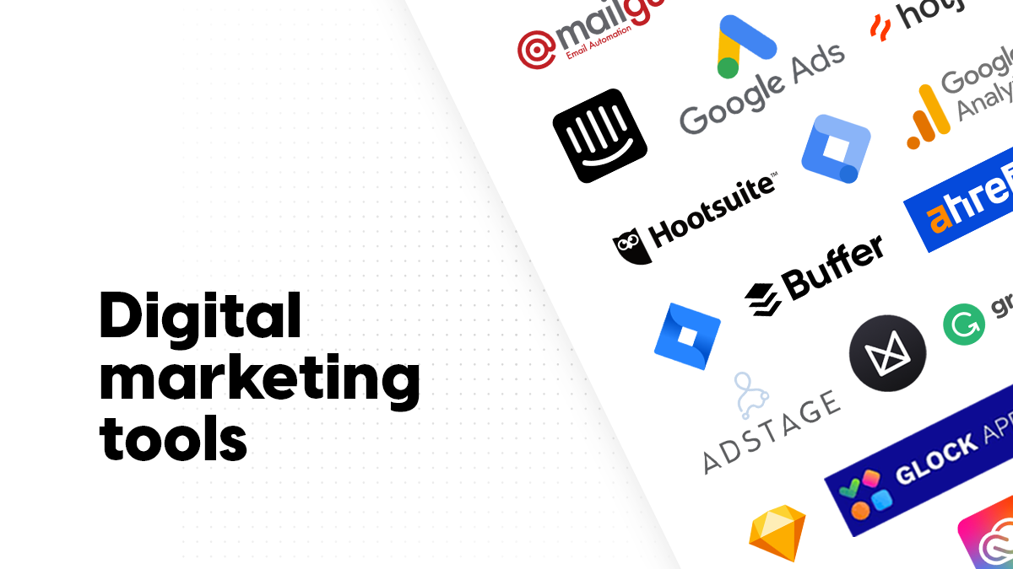

Slide 65
Google Analytics(KISSmetrics or Mixpanel): A powerful web analytics tool that helps track website traffic, user behavior, conversions, and more. It provides insights to optimize website performance and marketing strategies.
Google Ads (formerly AdWords): A platform for creating and managing online advertising campaigns. It allows you to display ads on Google's search engine and its advertising network.
Social Media Management Tools (e.g., Hootsuite, Buffer): These tools help schedule, manage, and analyze social media posts across various platforms. They offer features for content planning, engagement tracking, and reporting.
Email Marketing Platforms (e.g., Mailchimp, Constant Contact): These tools enable businesses to create, send, and track email campaigns. They often provide templates, automation, and analytics.
Search Engine Optimization (SEO) Tools (e.g., SEMrush, Moz): These tools help optimize websites for better search engine rankings. They offer insights into keyword research, backlink analysis, site auditing, and competitor analysis.

Slide 66
Content Management Systems (CMS) (e.g., WordPress, Drupal): While primarily used for website management, CMS platforms support content creation, publishing, and SEO optimization.
Customer Relationship Management (CRM) Software (e.g., Salesforce, HubSpot): These tools manage and analyze customer interactions, helping marketers personalize campaigns and track leads.
Marketing Automation Platforms (e.g., Marketo, Eloqua): These tools automate marketing tasks such as email campaigns, lead nurturing, and customer segmentation to improve efficiency.
Pay-Per-Click (PPC) Management Tools (e.g., WordStream, Optmyzr): Designed for managing PPC campaigns, these tools aid in keyword optimization, ad creation, and performance tracking.
Heatmap and User Behavior Tools (e.g., Crazy Egg, Hotjar): These tools visually represent how users interact with a website through heatmaps, session recordings, and user behavior analysis.
Social Media Analytics Tools (e.g., Sprout Social, Socialbakers): These platforms provide in-depth insights into social media engagement, demographics, and campaign performance.
Affiliate Marketing Platforms (e.g., ShareASale, ClickBank): These networks connect businesses with affiliates who promote their products or services in exchange for a commission.
Remember that the choice of tools depends on your specific goals and needs. It's essential to research and choose tools that align with your digital marketing strategies and provide the features you require.

Slide 67
Terminologies In
Digital Marketing

Slide 68
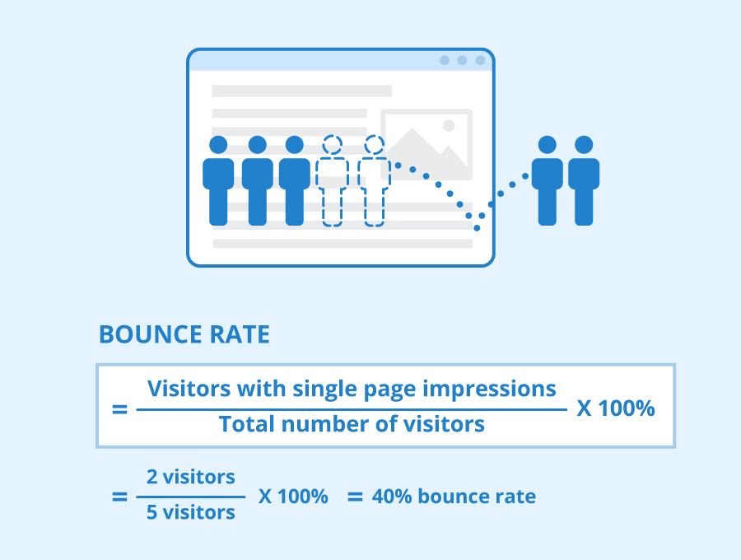
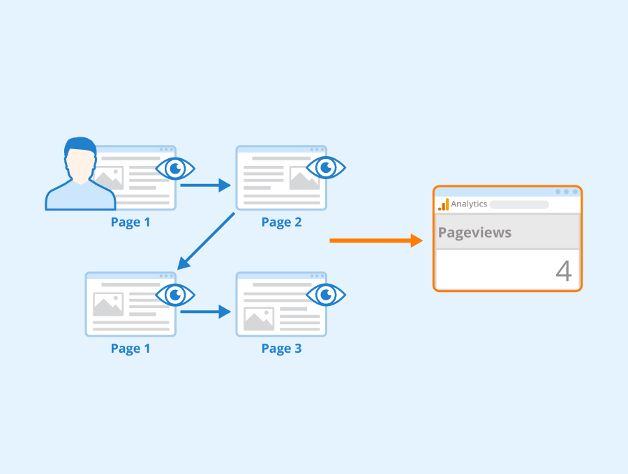
Bounce Rate: The percentage of website visitors who navigate away from the site after viewing only one page. A high bounce rate might indicate that visitors didn't find what they were looking for.
Pageviews: The total number of times a webpage has been viewed. Multiple views from the same user are counted.

Slide 69
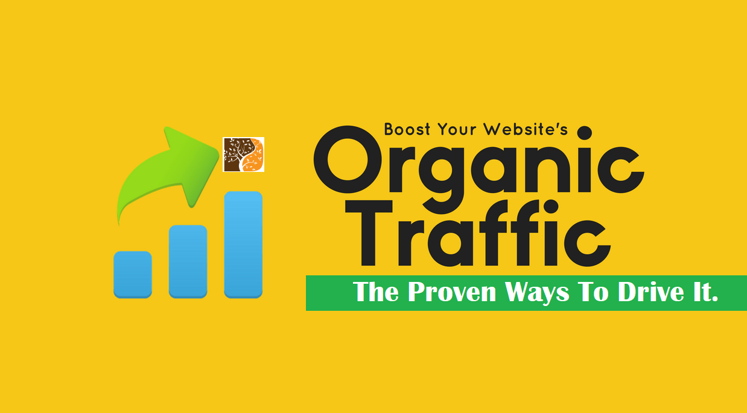
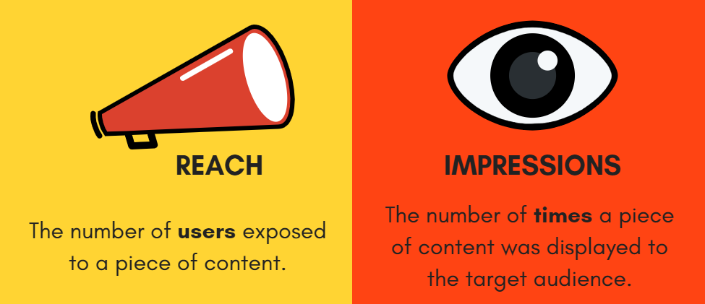
Organic Traffic: Visitors who come to a website through unpaid (organic) search engine results, as opposed to paid advertising.
Impressions: The number of times an ad or piece of content is displayed, regardless of whether it's clicked or interacted with.

Slide 70
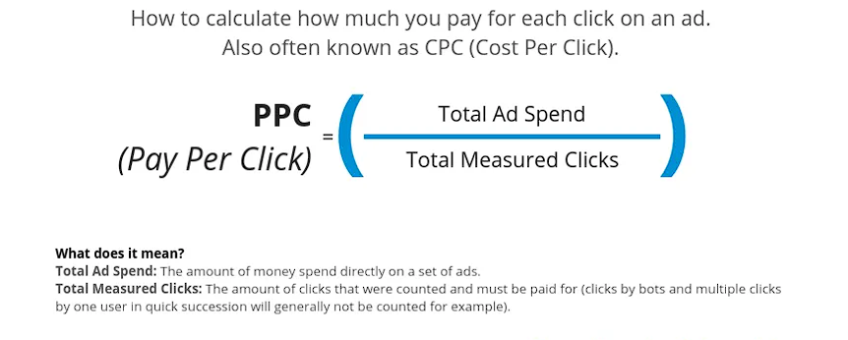
Pay-Per-Click (PPC): An advertising model where advertisers pay a fee each time their ad is clicked. It's a common form of online advertising, often associated with search engine advertising.

Slide 71
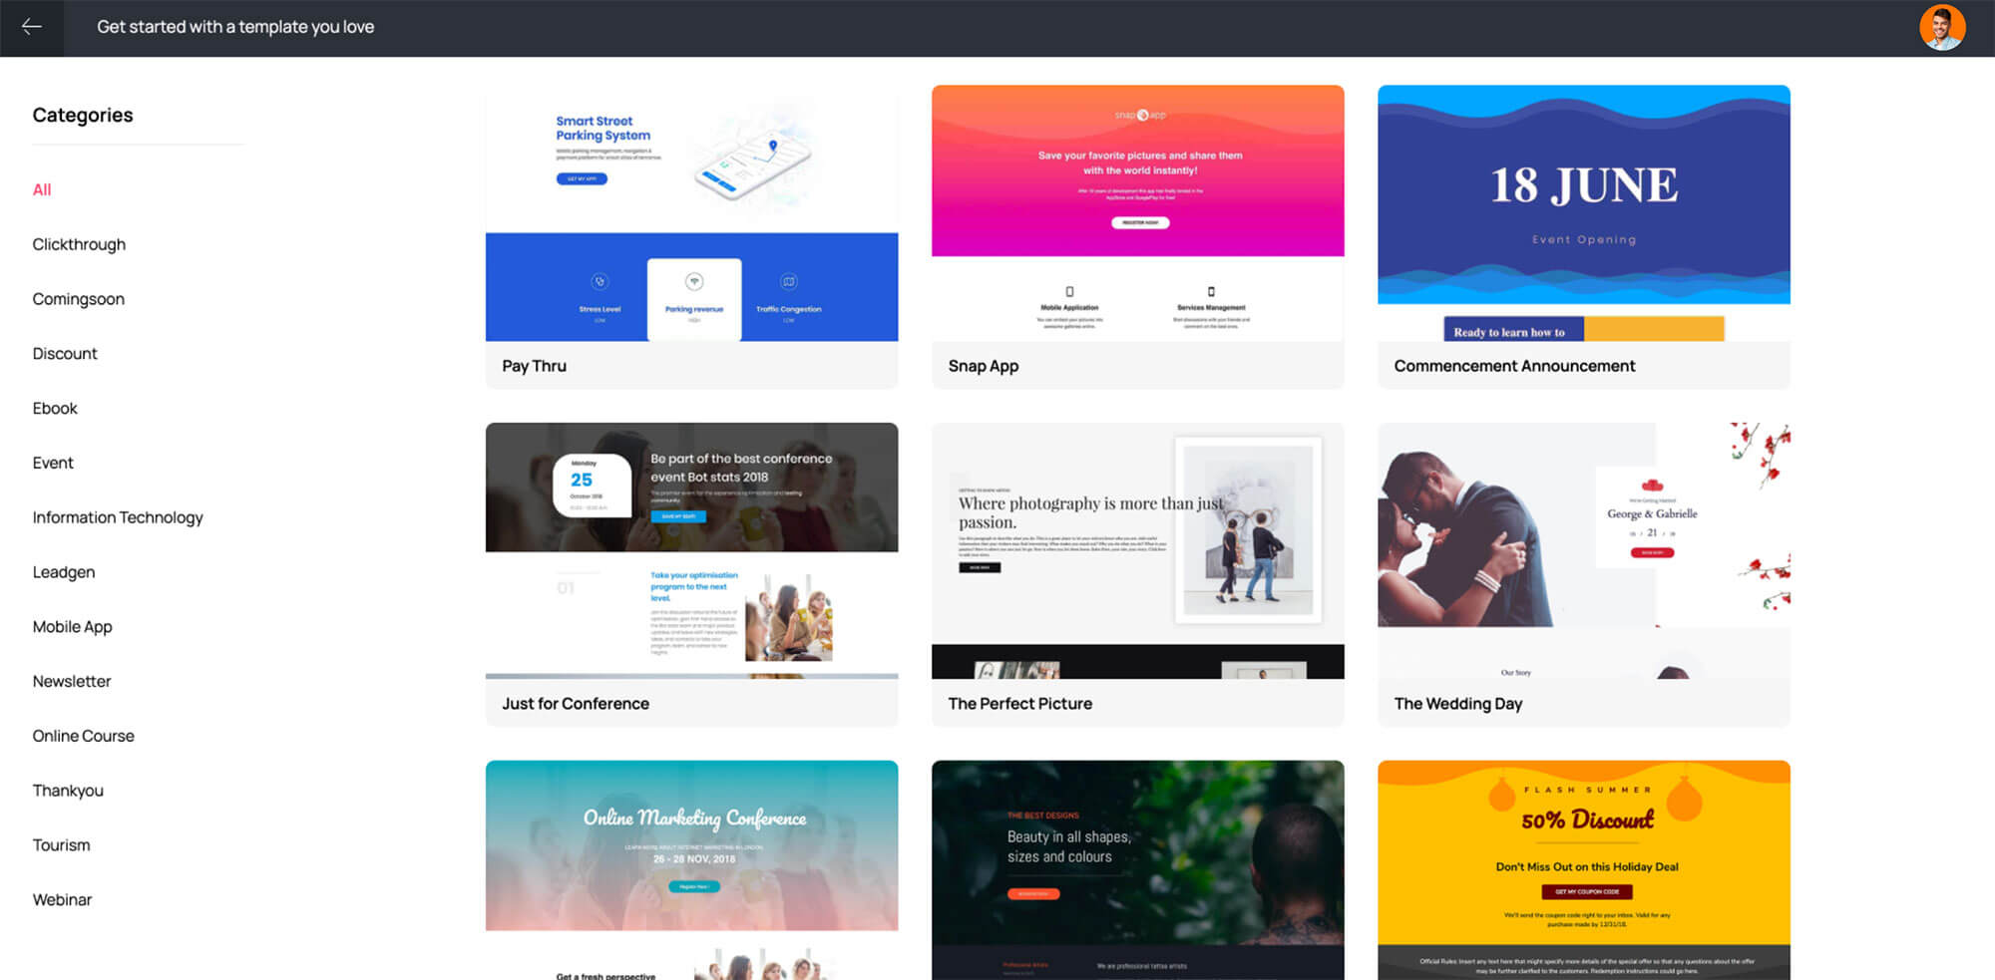
Landing Page: A web page designed specifically to receive and convert traffic from marketing campaigns, often with a clear call-to-action.
CTA (Call-to-Action): A statement or element that encourages users to take a specific action, like "Buy Now," "Sign Up," or "Learn More."

Slide 72
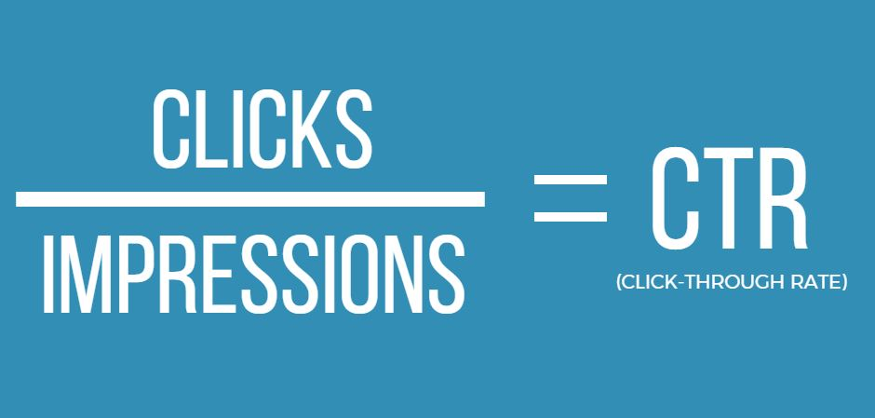
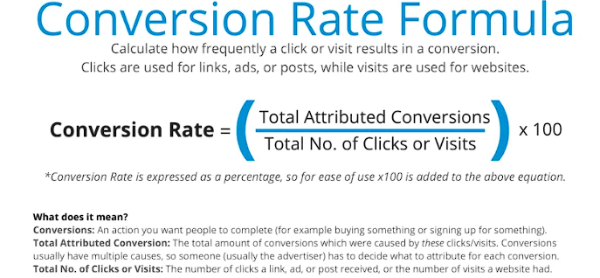

Slide 73
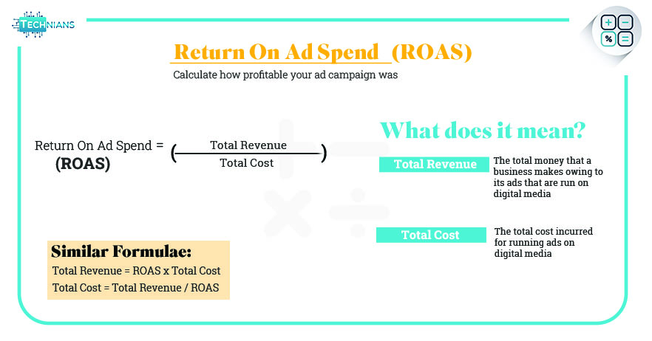
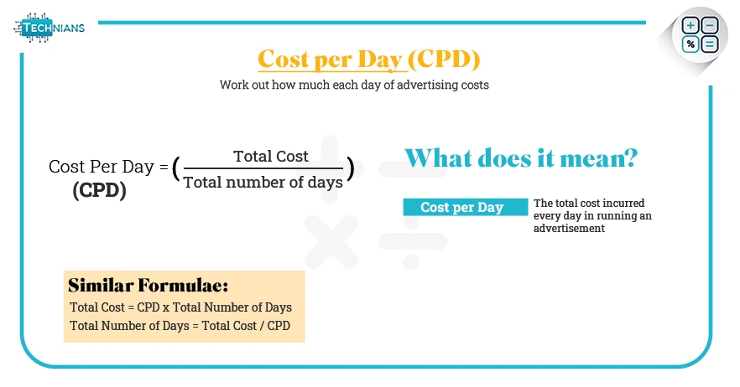

Slide 74
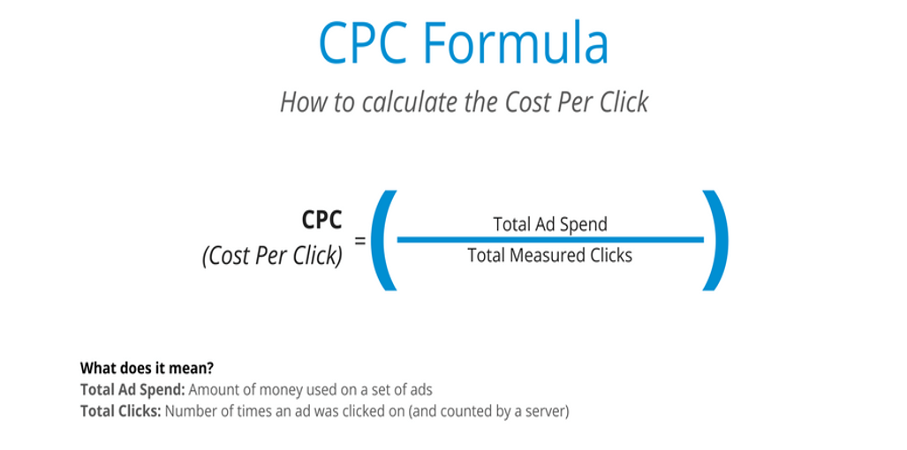
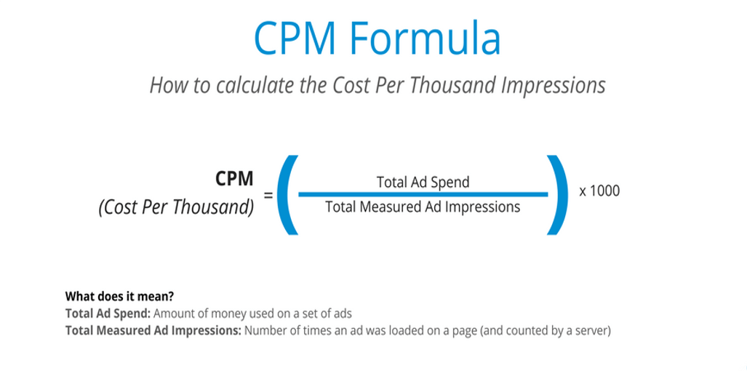

Slide 75
Methodologies In Digital Marketing

Slide 76
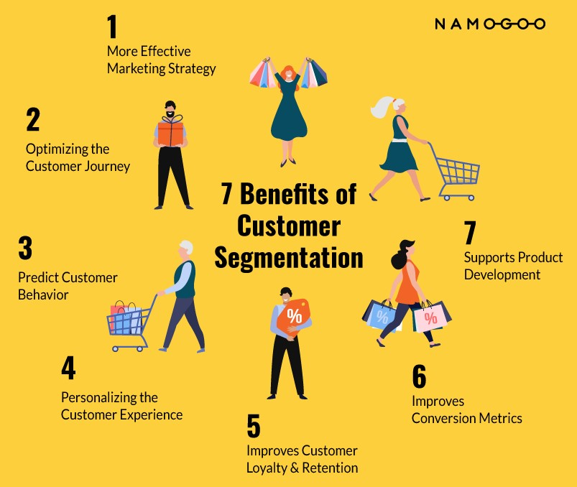
Segmentation Analysis:
Segmentation analysis involves dividing a larger audience into smaller, more homogeneous groups or segments based on shared characteristics or behaviors. These characteristics can include demographics (age, gender, location), psychographics (interests, lifestyle), behavior (purchase history, website interactions), or other relevant factors. The primary goal is to create targeted marketing strategies for each segment, tailoring content and messaging to better resonate with the specific needs and preferences of that group.
For example, an e-commerce business might segment its customers into groups such as "frequent shoppers," "new customers," and "lapsed customers." This allows them to send personalized offers or recommendations to each group, improving conversion rates and customer retention.

Slide 77
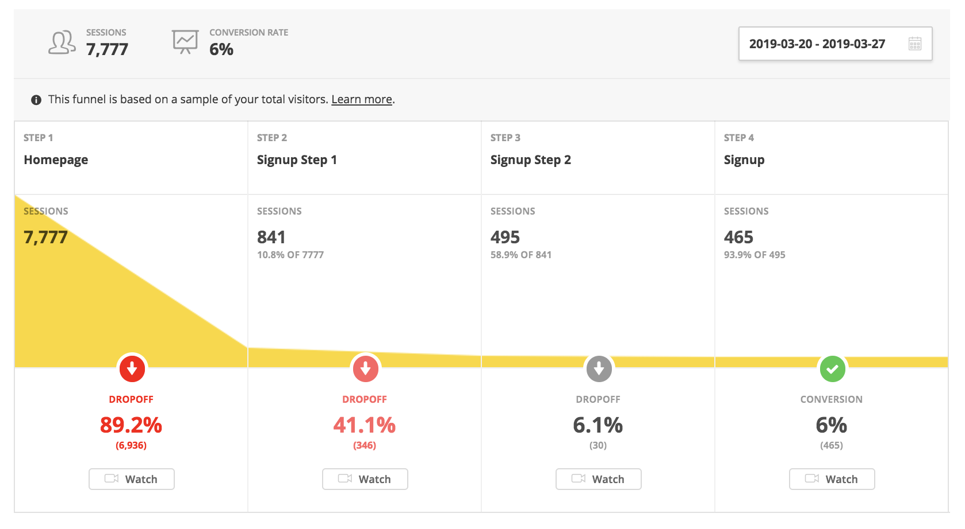
Funnel Analysis:
Funnel analysis is the process of tracking and analyzing the steps users take through a predefined conversion path or "funnel." Funnels are often used to visualize the customer journey, from initial awareness to final conversion (e.g., making a purchase or signing up for a newsletter). Each step in the funnel represents an interaction or stage in the customer's journey.
Funnel analysis helps digital marketers identify where users drop off or abandon the process and make optimizations accordingly. By understanding where potential customers are falling out of the funnel, marketers can make adjustments to improve user experience, messaging, or calls to action to increase conversion rates.
For instance, an e-commerce website might have a funnel consisting of these stages: "Homepage > Product Page > Add to Cart > Checkout > Purchase." Funnel analysis would reveal the drop-off points, allowing marketers to focus on optimizing these specific stages to reduce abandonment rates

Slide 78
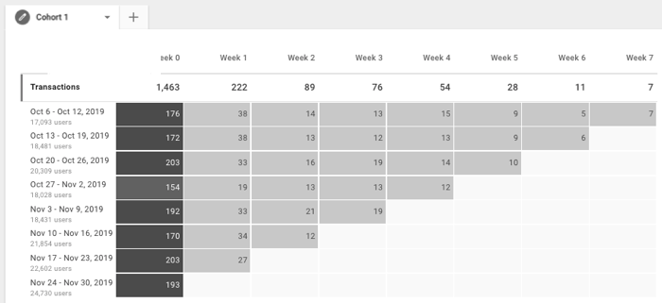
Cohort Analysis:
Cohort analysis involves grouping users who share a common characteristic or experience within a specific time frame. These groups, known as cohorts, are analyzed to gain insights into their behavior and performance over time. Cohort analysis helps digital marketers understand how user groups evolve and how marketing efforts impact user retention and engagement.
For example, a mobile app developer might group users based on their installation date and analyze how each cohort's retention rate changes over time. This can help identify whether updates or marketing campaigns have a positive impact on user retention for specific user groups.

